Slide 1

Book cover for Understanding Medical-Surgical Nursing, Seventh Edition.
Chapter 31
Nursing Care of Patients With Lower Respiratory Tract Disorders

Slide 2
Learning Outcomes
Explain the pathophysiology of each of the disorders of the lower respiratory tract.
Describe the etiologies and signs and symptoms of each of the disorders.
Identify tests that are used to diagnose lower respiratory disorders.
Describe therapeutic measures used for disorders of the lower respiratory tract.

Slide 3
Learning Outcomes (continued)
List data to collect when caring for patients with disorders of the lower respiratory tract.
Assist in planning nursing care for patients with disorders of the lower respiratory tract.
Identify interventions for patients experiencing impaired gas exchange, ineffective airway clearance, or ineffective breathing pattern.
Explain how you will know if your nursing interventions have been effective.

Slide 4
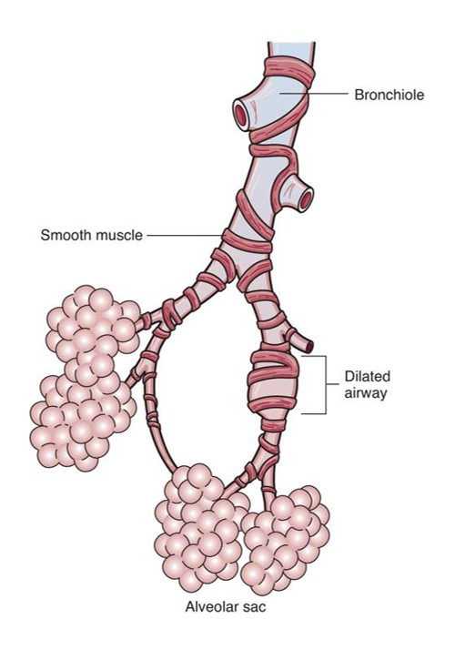
Bronchiectasis
Pathophysiology
Chronic infection
Dilation of one or more large bronchi
Airway obstruction
Etiology
Secondary to cystic fibrosis, asthma, tuberculosis (TB)

Slide 5
Bronchiectasis (continued_1)
Signs and symptoms
Dyspnea
Cough
Large amounts of sputum
Anorexia
Recurrent infection
Clubbing
Crackles and wheezes

Slide 6
Bronchiectasis (continued_2)
Diagnostic tests
X-ray
Computed tomography (CT) scan
Sputum culture
Tests to find underlying cause

Slide 7
Bronchiectasis (continued_3)
Therapeutic interventions
Antibiotics
Mucolytics, expectorants
Bronchodilators
Chest physiotherapy (CPT)
Oxygen
Surgical resection

Slide 8
Pneumonia
Pathophysiology
Acute lung infection
Inflammation and alveolar damage
Alveoli filled with exudate
Reduced surface area for gas exchange

Slide 9
Pneumonia (continued_1)
Etiology
Bacteria, usually Streptococcus pneumoniae
Virus
Fungus
Aspiration
Artificial ventilation (ventilator-associated pneumonia [VAP])
Chemical

Slide 10
Pneumonia (continued_2)
Persons at risk
Very young
Elderly
Hospitalized
Intubated
Immunocompromised

Slide 11
Pneumonia (continued_3)
Prevention
Pneumococcal vaccine
Flu vaccine
Coughing and deep breathing
Hand washing
Frequent mouth care, continuous suction for VAP

Slide 12
Pneumonia (continued_4)
Signs and symptoms
Chest pain
Fever, chills
Cough, dyspnea
Yellow, rusty, or blood-tinged sputum
Crackles, wheezes
Malaise

Slide 13
Pneumonia (continued_5)
Signs and symptoms in elderly
New onset
Confusion
Lethargy
Fever
Dyspnea

Slide 14
Pneumonia (continued_6)
Complications
Pleurisy
Pleural effusion
Atelectasis
Spread of infection

Slide 15
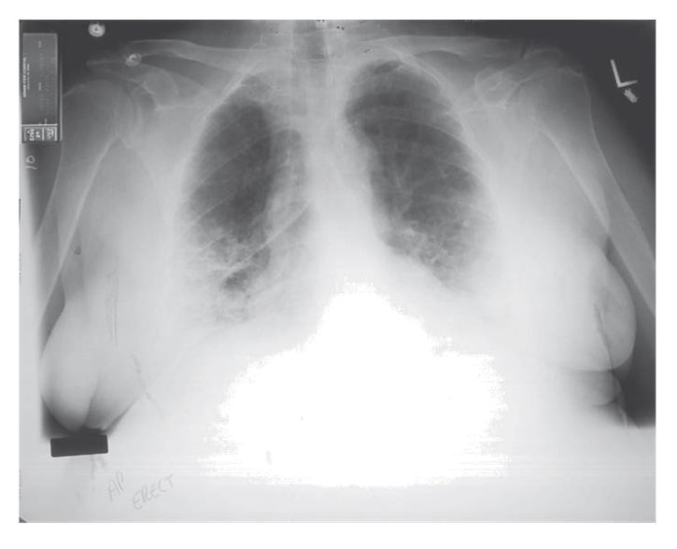
Pneumonia (continued_7)
Diagnostic tests
Chest x-ray
Sputum culture
Blood cultures

Slide 16
Pneumonia (continued_8)
Therapeutic interventions
Antibiotics: By mouth (PO) or IV
Antiviral medication
Bronchodilators
Expectorants
Oxygen
Fluids

Slide 17
Tuberculosis
Pathophysiology
Acid-fast bacillus implant on bronchioles or alveoli
Tubercle formed
Immune system keeps in check
5% to 10% infected become ill
May activate with impaired immunity

Slide 18
Tuberculosis (continued_1)
Persons at risk
Elderly
Alcoholics
Those living in crowded conditions
New immigrants
Those with HIV

Slide 19
Tuberculosis (continued_2)
Signs and symptoms
Cough
Blood-tinged sputum
Night sweats
Anorexia and weight loss
Low-grade fever
Dyspnea, chest pain (late)

Slide 20
Tuberculosis (continued_3)
Diagnostic tests
Purified protein derivative skin test
Chest x-ray
Sputum cultures
QuantiFERON-TB and T-SPOT tests

Slide 21
Tuberculosis (continued_4)
Therapeutic interventions
Combination of drugs for 6 to 24 months
Isoniazid
Rifampin
Ethambutol
Pyrazinamide
Occasional surgical removal
Isolation

Slide 22
Nursing Diagnoses for Lower Respiratory Disorders
Impaired Gas Exchange
Ineffective Airway Clearance
Ineffective Breathing Pattern
Activity Intolerance

Slide 23
Impaired Gas Exchange
Monitor
Lung sounds, respiratory rate and effort
Dyspnea
Mental status
Peripheral capillary oxygen saturation (SpO₂), arterial blood gases (ABGs)
Position
Fowler
“Good lung down”
Administer oxygen.
Teach breathing exercises.
Discourage smoking.

Slide 24
Ineffective Airway Clearance
Monitor
Lung sounds
Sputum
Encourage
Fluids
Deep breathing
Coughing
Administer expectorants.
Turn every 2 hours daily or ambulate.
Suction as needed (prn).
Consider CPT or mucus clearance device.

Slide 25
Ineffective Breathing Pattern
Monitor.
Respiratory rate, depth, effort
ABGs, SpO₂
Determine/treat cause.
Position.
Teach diaphragmatic breathing.

Slide 26
Decreased Activity Tolerance
Monitor response to activity.
Vital signs
SpO₂
Use portable O₂ for ambulation.
Allow rest between activities.
Obtain bedside commode.
Increase activity slowly.
Refer to pulmonary rehabilitation.

Slide 27
Additional Diagnosis for Tuberculosis
Ineffective health management
Teach patient and family to
Take drugs as scheduled for the entire course.
Consider home health-care nurse/directly observed therapy.
Avoid spreading the disease to others.

Slide 28
Prevention of Tuberculosis Spread
Clean, well-ventilated living areas
Isolation of patients who have active TB
High-efficiency filtration masks
Gowns, gloves, goggles if contact with sputum likely

Slide 29
Restrictive Disorders
Reduced compliance
Limited chest wall expansion

Slide 30
Pleurisy (Pleuritis)
Pathophysiology
Inflammation of visceral and parietal pleurae
Friction between pleurae on inspiration
Etiology
Secondary to pneumonia, TB, cancer

Slide 31
Pleurisy (Pleuritis) (continued_1)
Signs and symptoms
Sharp pain on inspiration
Shallow breathing
Fever, elevated white blood cells
Friction rub

Slide 32
Pleurisy (Pleuritis) (continued_2)
Diagnostic tests
Chest x-ray
Complete blood count (CBC)
Forced vital capacity (FVC), forced expiratory volume in 1 second (FEV1)
Tests to determine cause

Slide 33
Pleurisy (Pleuritis) (continued_3)
Therapeutic interventions
Pain management
Treat underlying cause

Slide 34
Pleural Effusion
Pathophysiology
Excess fluid between visceral and parietal pleurae
Pleural fluid not reabsorbed
May collapse lung

Slide 35
Pleural Effusion (continued_1)
Etiology
Transudative
Heart failure
Liver or kidney disease
Exudative
Pneumonia
TB
Cancer

Slide 36
Pleural Effusion (continued_2)
Signs and symptoms
Dyspnea
Pain
Cough
Tachypnea
Diminished lung sounds

Slide 37
Pleural Effusion (continued_3)
Diagnostic tests
Chest x-ray
Thoracentesis
Tests to determine cause

Slide 38
Pleural Effusion (continued_4)
Therapeutic interventions
Treat underlying cause
Analgesics
Thoracentesis/chest tube

Slide 39
Pulmonary Fibrosis
Pathophysiology
Injury to alveoli
Scarring, fibrosis
Impaired gas exchange
Etiology
Heredity
Virus
Environmental/ occupational exposure
Immune dysfunction
Idiopathic

Slide 40
Pulmonary Fibrosis (continued_1)
Signs and symptoms
Progressive dyspnea
Crackles
Chronic cough
Fatigue
Clubbing

Slide 41
Pulmonary Fibrosis (continued_2)
Diagnostic tests
Chest x-ray
CT scan
ABGs
Bronchoscopy
Lung biopsy
Antinuclear antibodies titer

Slide 42
Pulmonary Fibrosis (continued_3)
Therapeutic interventions
Pirfenidone (Esbriet)
Nintedanib (Ofev)
Smoking cessation
Oxygen
Flu/pneumonia vaccines
Pulmonary rehabilitation
Lung transplant

Slide 43
Atelectasis
Pathophysiology
Collapse of alveoli
Etiology
Hypoventilation
Signs and symptoms
Fine crackles
Diminished breath sounds
Dyspnea

Slide 44
Atelectasis (continued)
Therapeutic interventions
Prevention
Cough and deep breathe
Incentive spirometer
Turn
Ambulate

Slide 45
Nursing Diagnoses for Restrictive Disorders
Ineffective Breathing Pattern
Impaired Gas Exchange
Ineffective Airway Clearance
Activity Intolerance

Slide 46
Obstructive Disorders
Airway obstruction
Difficult exhalation

Slide 47
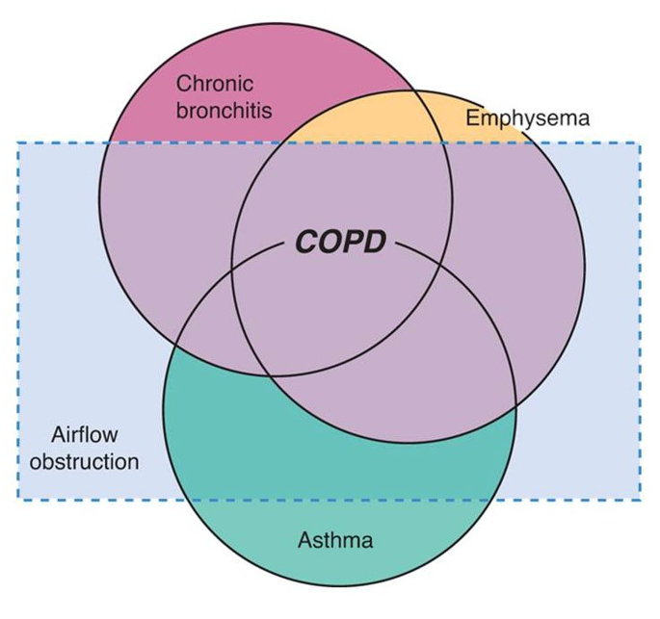
Chronic Obstructive Pulmonary Disease (COPD)
Combination of
Chronic bronchitis
Emphysema (asthma)
Chronic airflow limitation

Slide 48
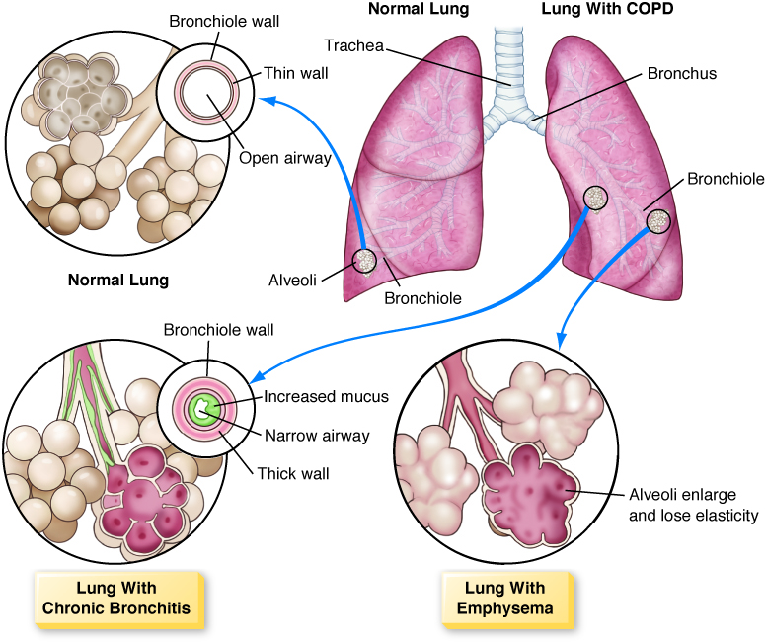
Chronic Obstructive Pulmonary Disease (COPD) (continued_1)

Slide 49
Chronic Obstructive Pulmonary Disease (COPD) (continued_2)
Pathophysiology
Chronic bronchitis
Chronic inflammation
Low-grade infection
Hypertrophied mucous glands in bronchi
Impaired ciliary function
Ineffective airway clearance
Diagnosed after ill for 3 months of year for 2 consecutive years

Slide 50
Chronic Obstructive Pulmonary Disease (COPD) (continued_3)
Pathophysiology (continued)
Emphysema
Destruction of alveolar walls
Loss of elastic recoil
Damage to pulmonary capillaries
Air trapping
Impaired gas exchange

Slide 51
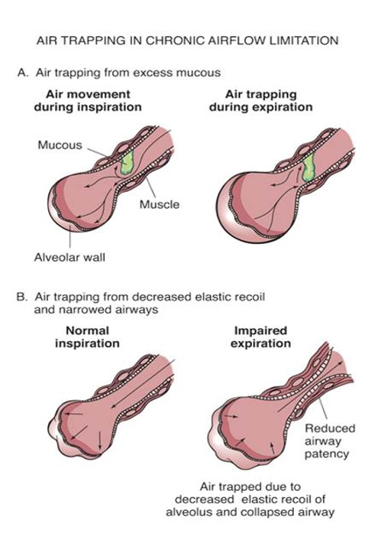
Air Trapping

Slide 52
Chronic Obstructive Pulmonary Disease (COPD) (continued_4)
Etiology
Smoking
Passive smoke exposure
Pollutants
Familial predisposition
Alpha-1 antitrypsin (AAT) deficiency (emphysema)

Slide 53
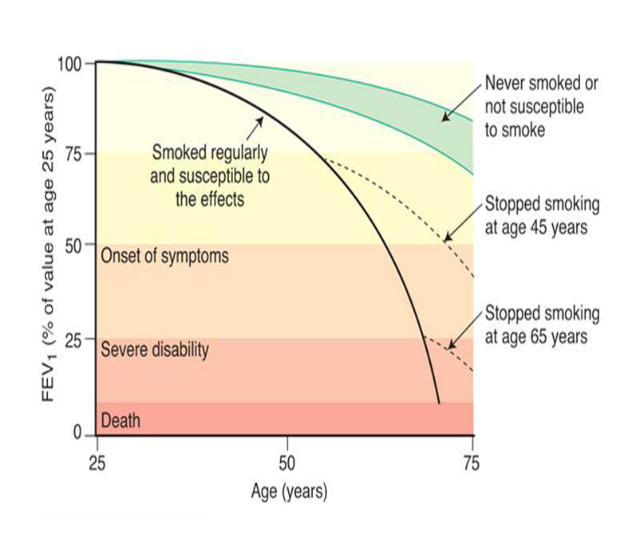
Effects of Smoking

Slide 54

COPD Prevention
No smoking!

Slide 55
Chronic Obstructive Pulmonary Disease (COPD) (continued_5)
Signs and symptoms
Cough
Sputum production
Dyspnea
Prolonged expiration
Barrel chest
Activity intolerance

Slide 56
Chronic Bronchitis
Signs and symptoms
Wheezing, crackles
Chronic cough
Dyspnea
Thick, tenacious sputum
Increased susceptibility to infection
Mucus plugs

Slide 57
Emphysema
Signs and symptoms
Diminished breath sounds
Dyspnea
Progressive activity intolerance

Slide 58
Chronic Obstructive Pulmonary Disease (COPD) (continued_6)
Complications
Cor pulmonale
Weight loss
Pneumothorax
Bullae
Blebs
Respiratory failure

Slide 59
Chronic Obstructive Pulmonary Disease (COPD) (continued_7)
Diagnostic tests
Chest x-ray
CT scan
ABGs
CBC
Alpha-1 AT level
Spirometry
Sputum analysis

Slide 60
Chronic Obstructive Pulmonary Disease (COPD) (continued_8)
Therapeutic interventions
Stop smoking!
Oxygen
Supportive care
Pulmonary rehabilitation
Surgery
Endobronchial valve
Mechanical ventilation
End-of-life planning
Medications
Bronchodilators
Corticosteroids
Expectorants
Nebulized mist treatments/metered- dose inhalers

Slide 61
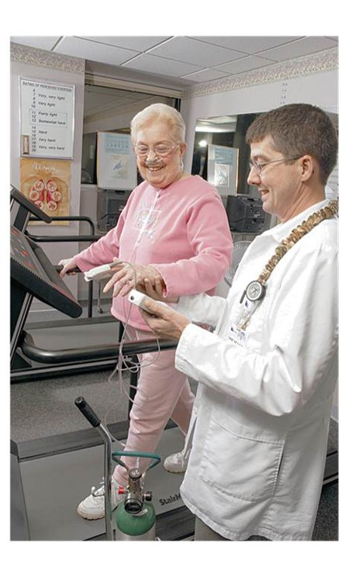
Pulmonary Rehabilitation

Slide 62
Nursing Diagnoses for COPD
Impaired Gas Exchange
Ineffective Airway Clearance
Activity Intolerance

Slide 63
Asthma
Pathophysiology
Inflammation of bronchial mucosa
Spasm of bronchial smooth muscles
Air trapping
Usually reversible
Airway remodeling

Slide 64
Asthma (continued_1)
Etiology
Heredity
Airborne allergies
Pollution
Smoking
Triggers
Smoking
Allergens
Infection
Sinusitis
Exercise
Stress
Some medications

Slide 65
Asthma (continued_2)
Signs and symptoms
Dyspnea
Wheezing
Cough
Sputum
Use of accessory muscles
May be worse at night

Slide 66
Asthma (continued_3)
Complication
Status asthmaticus
Severe, sustained asthma
Worsening hypoxemia
Respiratory alkalosis progresses to respiratory acidosis
May be life-threatening

Slide 67
Asthma (continued_4)
Diagnostic tests
History and physical examination
Spirometry
ABGs
Allergy skin and blood testing

Slide 68
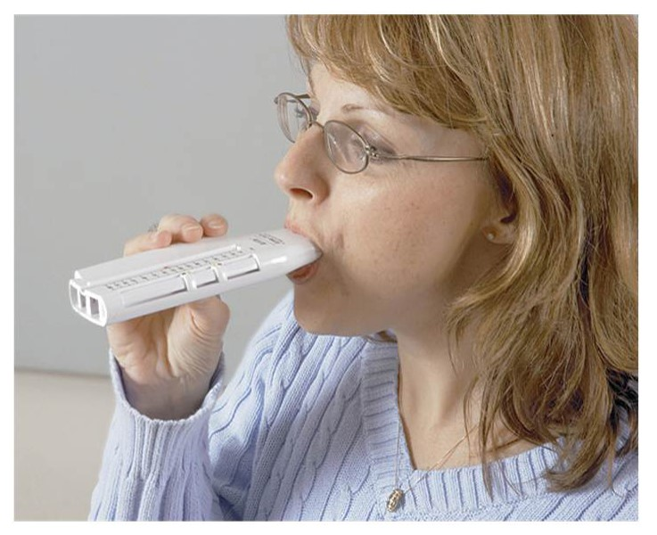
Asthma (continued_5)
Therapeutic interventions
Monitor with peak flow meter.
Avoid triggers.
Avoid smoking.

Slide 69
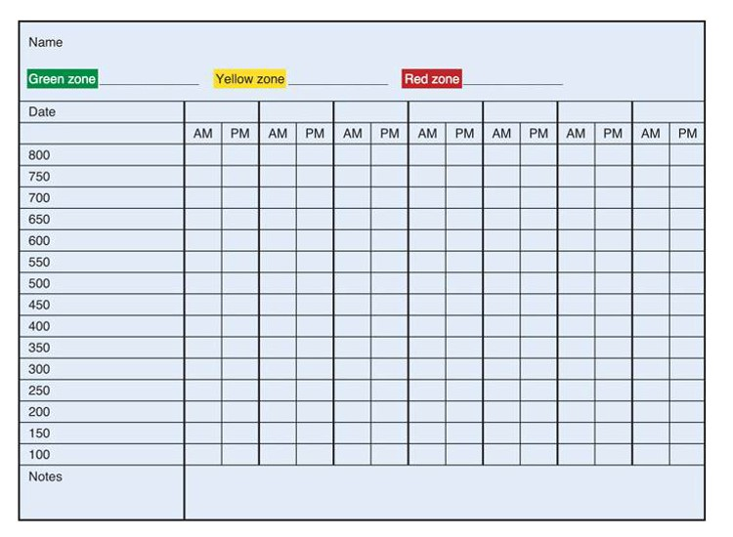
Peak Flow Chart

Slide 70
Asthma (continued_6)
Therapeutic interventions (continued)
Bronchodilators
Short-acting beta agonists (SABAs), long-acting beta agonists (LABAs)
Leukotriene inhibitors: Zafirlukast (Accolate), montelukast (Singulair)
Corticosteroids
Inhaled, IV, PO
Combined inhaled LABA with corticosteroid
Oxygen as needed

Slide 71
Cystic Fibrosis
Pathophysiology
Exocrine gland disorder
Thick, tenacious secretions
Blocked pancreatic enzymes
Etiology
Heredity

Slide 72
Cystic Fibrosis (continued_1)
Signs and symptoms
Thick, tenacious sputum
Frequent respiratory infections
Finger clubbing
Malabsorption
Fatty, foul-smelling stools
Death from antibiotic-resistant infection

Slide 73
Cystic Fibrosis (continued_2)
Diagnostic tests
Genetic testing
Blood immunoreactive trypsinogen
“Kiss your baby” campaign
Sweat chloride test
Chest x-ray
Spirometry
Gastrointestinal testing

Slide 74
Cystic Fibrosis (continued_3)
Therapeutic interventions
Hydration
Inhaled mucolytic medication
Inhaled hypertonic saline
Bronchodilators, corticosteroids
Expectorants
CPT
Prevent infection
Antibiotics

Slide 75
Cystic Fibrosis (continued_4)
Therapeutic interventions (continued)
Dornase alfa (Pulmozyme)
Ivacaftor (Kalydeco)
Pancreatic enzyme replacement (Pancrease, Viokase)
Ibuprofen may slow lung deterioration.
Lung transplant

Slide 76
Pulmonary Embolism
Pathophysiology
Blood clot in pulmonary artery
Ventilation-perfusion mismatch
Impaired gas exchange
Lung infarction

Slide 77
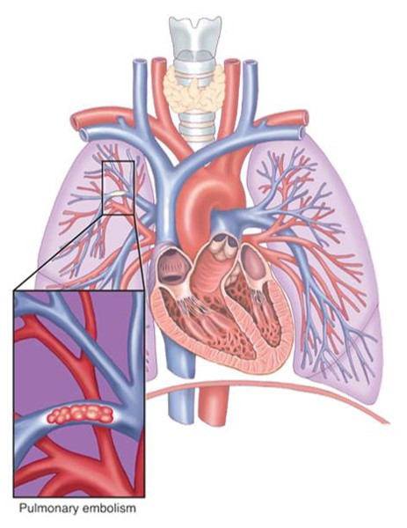
Pulmonary Embolism (continued_1)

Slide 78
Pulmonary Embolism (continued_2)
Etiology
Deep vein thrombosis (DVT) most common
Fat emboli from compound fracture
Amniotic fluid emboli during labor and delivery

Slide 79
Pulmonary Embolism (continued_3)
Prevention
Regular ambulation
Prompt treatment of DVT
Anticoagulant medication in high-risk patients

Slide 80
Pulmonary Embolism (continued_4)
Signs and symptoms
Sudden onset dyspnea
Tachycardia
Tachypnea
Cough
Crackles
Hemoptysis

Slide 81
Pulmonary Embolism (continued_5)
Diagnostic tests
D-dimer
Spiral CT scan
Lung scan
Angiogram

Slide 82
Pulmonary Embolism (continued_6)
Therapeutic interventions
Thrombolytics
Anticoagulants
Oxygen
Embolectomy (rare)
Jugular or femoral filter for recurrent pulmonary embolism

Slide 83
Pulmonary Embolism (continued_7)
Nursing diagnoses
Impaired Gas Exchange
Anxiety
Risk for Bleeding Related to Anticoagulant Therapy

Slide 84
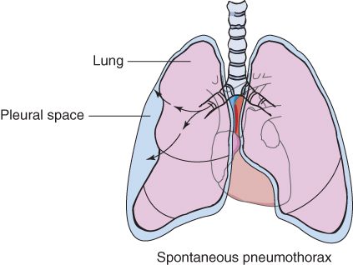
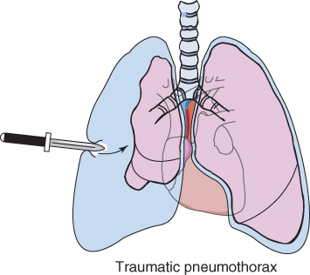
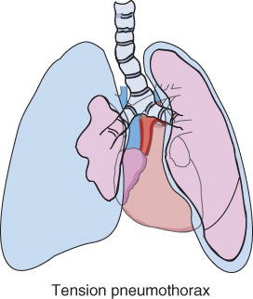
Pneumothorax
Air in the intrapleural space
Complete or partial collapse of lung
Types (shown below)

Slide 85
Pneumothorax (continued_1)
Signs and symptoms
Shallow, rapid respirations
Asymmetrical chest expansion
Dyspnea
Chest pain
Absent breath sounds over affected area

Slide 86
Tension Pneumothorax
Signs and symptoms
Tracheal deviation
Bradycardia
Cyanosis
Shock and death if untreated

Slide 87
Pneumothorax (continued_2)
Diagnostic tests
History and physical examination
Bedside ultrasound
Chest x-ray
ABGs, SpO₂

Slide 88
Pneumothorax (continued_3)
Therapeutic interventions
Monitor ABGs and respiratory status.
Chest tube to water seal drainage
Pleurodesis (sclerosis) for recurrent collapse

Slide 89
Pneumothorax (continued_4)
Nursing care
Monitor respiratory status.
Monitor chest drainage system.
Report changes promptly.

Slide 90
Rib Fractures
Etiology
Trauma
Cough
CPR
Care
Control pain.
Encourage coughing and deep breathing.
Promote adequate ventilation.

Slide 91
Flail Chest
Cause
Multiple rib fractures
Ribcage not able to maintain bellows action
Care
Monitor ABGs.
Mechanical ventilation

Slide 92
Nursing Diagnoses for Chest Trauma
Impaired Gas Exchange
Ineffective Breathing Pattern
Acute Pain

Slide 93
Acute Respiratory Failure
Pathophysiology
Hypoventilation
Unable to maintain ABGs
Etiology
COPD
Aspiration
Neurological disease
Opioid overdose

Slide 94
Acute Respiratory Failure (continued_1)
Signs and symptoms
Worsening ABGs
Increasing dyspnea
Restlessness, confusion
Lethargy
Coma and death

Slide 95
Acute Respiratory Failure (continued_2)
Diagnostic tests
ABGs
Partial pressure of oxygen (PaO₂) <60 millimeters of mercury
Partial pressure of carbon dioxide (PaCO₂) >50 millimeters of mercury
Tests to determine cause

Slide 96
Acute Respiratory Failure (continued_3)
Therapeutic interventions
Oxygen to maintain SpO₂ 88% to 92%
Bronchodilators
Correct underlying cause
Intubation and ventilation
Check advance directives.

Slide 97
Acute Respiratory Distress Syndrome (ARDS)
Pathophysiology
Alveolocapillary membrane damage
Pulmonary edema
Alveolar collapse
Lungs stiff and noncompliant
Lungs may hemorrhage

Slide 98
Acute Respiratory Distress Syndrome (ARDS) (continued_1)
Etiology
Acute lung injury
Sepsis
Shock
Aspiration
Not usually in patients with chronic respiratory disease

Slide 99
Acute Respiratory Distress Syndrome (ARDS) (continued_2)
Signs and symptoms
Dyspnea
Elevated respiratory rate
Fine crackles
Respiratory acidosis
Restlessness, confusion
Death rate 40%

Slide 100
Acute Respiratory Distress Syndrome (ARDS) (continued_3)
Diagnostic tests
ABGs
Chest x-ray
CT scan
Electrocardiogram
Tests to determine cause

Slide 101
Acute Respiratory Distress Syndrome (ARDS) (continued_4)
Therapeutic interventions
Oxygen
Intubation
Mechanical ventilation
Treat underlying cause.
Supportive care

Slide 102
Nursing Diagnoses for Respiratory Failure
Impaired Gas Exchange
Ineffective Airway Clearance
Ineffective Breathing Pattern
Activity Intolerance
Anxiety
Risk for Acute Confusion
Self-Care Deficit

Slide 103
Lung Cancer
Small cell lung cancer
Large cell carcinoma
Adenocarcinoma
Squamous cell carcinoma

Slide 104
Lung Cancer (continued_1)
Etiology
Smoking
Smoking causes 80% to 90% of lung cancers.
Environmental tobacco smoke
Other carcinogens
Asbestos
Arsenic
Pollution

Slide 105
Lung Cancer (continued_2)
Signs and symptoms
None until late
Productive cough
Recurrent infection
Dyspnea
Hemoptysis
Anorexia and weight loss
Pain
Wheezing/stridor

Slide 106
Lung Cancer (continued_3)
Complications
Pleural effusion
Superior vena cava syndrome
Ectopic hormone secretion
Antidiuretic hormone (ADH; syndrome of inappropriate ADH [SIADH])
Adrenocorticotropic hormone (ACTH; Cushing syndrome)
Metastasis

Slide 107
Lung Cancer (continued_4)
Diagnostic tests
Chest x-ray
CT scan
Sputum analysis
Biopsy
Additional tests to find metastasis

Slide 108
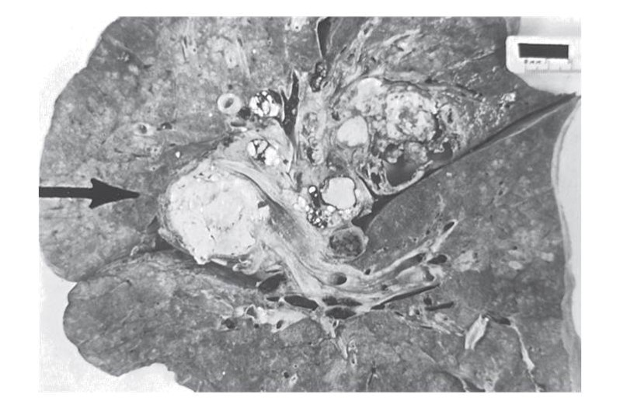
Lung Cancer (continued_5)

Slide 109
Lung Cancer (continued_6)
Therapeutic interventions
Stage (tumor-node-metastasis system)
Chemotherapy (usually palliative)
Radiation (usually palliative)

Slide 110
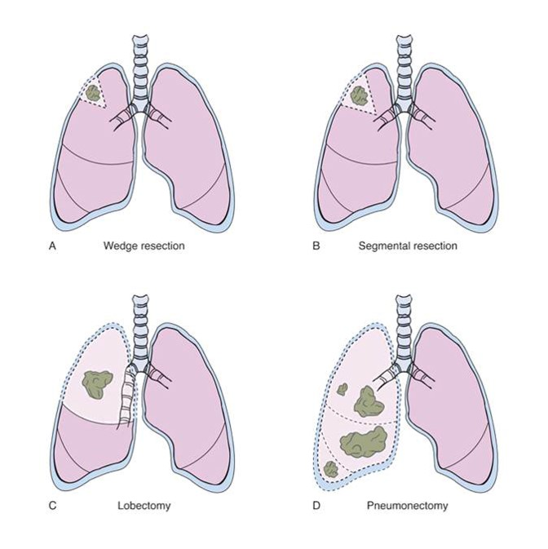
Lung Cancer (continued_7)
Therapeutic interventions (continued)

Slide 111
Lung Cancer (continued_8)
Nursing diagnoses
Impaired Gas Exchange
Ineffective Airway Clearance
Imbalanced Nutrition
Acute Pain
Constipation
Grieving
Activity Intolerance

Slide 112
Thoracic Surgery
Pneumonectomy
Lobectomy
Resection
Video-assisted thoracoscopic surgery
Transplant

Slide 113
Thoracic Surgery (continued_1)
Preoperative care
Monitor respiratory status.
Teach
Routine pre-op teaching
What to expect
Visit surgical intensive care unit.
Include family.

Slide 114
Thoracic Surgery (continued_2)
Postoperative care
Intensive care setting
Monitor
Vital signs
SpO₂, ABGs
Hemodynamic parameters
Lung sounds
Ventilator
Chest tubes

Slide 115
Thoracic Surgery (continued_3)
Nursing diagnoses
Ineffective Airway Clearance
Impaired Gas Exchange
Acute Pain
Impaired Physical Mobility
Risk for Infection

Slide 116
Review Question #1
What are symptoms of bacterial pneumonia? Select all that apply.
Fever
Dry cough
Hemoptysis
Diminished lung sounds
Shaking chills

Slide 117
Review Question #1 Answer
Correct Answer: 1, 3, 5

Slide 118
Review Question #2
What percent of people infected with mycobacterium tuberculosis develop TB disease?
10%
30%
50%
100%

Slide 119
Review Question #2 Answer
Correct Answer: 1

Slide 120
Review Question #3
When reading a purified protein derivative test, the nurse should check for which finding?
Redness
Edema
Itching
Induration

Slide 121
Review Question #3 Answer
Correct Answer: 4

Slide 122
Review Question #4
What are nursing interventions for impaired gas exchange? Select all that apply.
Administer oxygen.
Place patient in Fowler position.
Administer morphine as needed.
Provide a room humidifier.
Encourage use of vibratory positive expiratory pressure device.

Slide 123
Review Question #4 Answer
Correct Answer: 1, 2, 3

Slide 124
Review Question #5
Which of the following is a restrictive disorder?
Emphysema
Chronic bronchitis
Pleuritis
Asthma

Slide 125
Review Question #5 Answer
Correct Answer: 3

